Slide 1
Light-guided electrodeposition of non-noble catalyst patterns for photoelectrochemical hydrogen evolution
Sung Yul Lim, Yang-Rae Kim, Kyungyeon Ha, Jong-Kwon Lee, Jae Gyeong Lee, Woohyuk Jang, Jin-Young Lee, Je Hyun Bae and Taek Dong Chung
Energy & Environmental Science, 2015
Zoe Readi-Brown

Slide 2
Light-guided spatially selective electrodeposition on a-Si at 632.8 nm
Pt⁴⁺ + 4e⁻ → Pt⁰

Slide 3
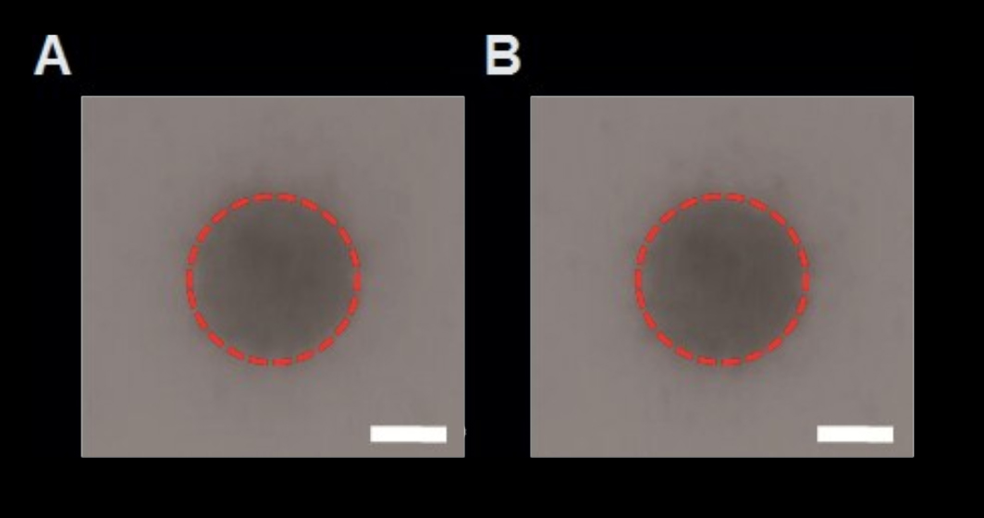
Minimal change occurs before and after the Pt nanoparticles are washes, demonstrating their adherence to the oxide surface

Slide 4
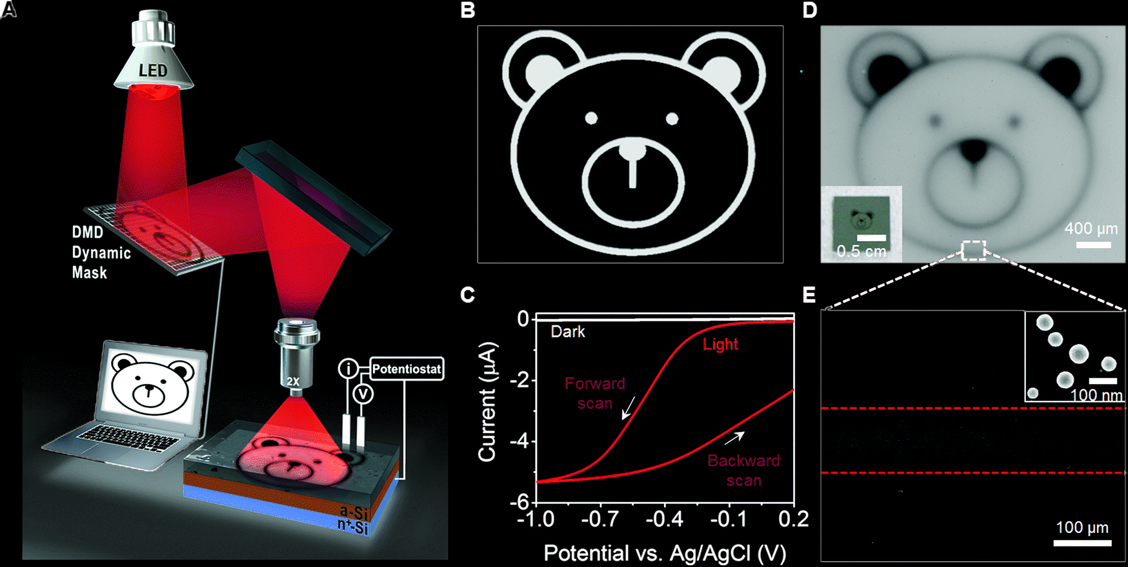
DMD dynamic mark system for irreversible patterned electrodeposition
Pt⁴⁺ + 4e⁻ → Pt⁰

Slide 5
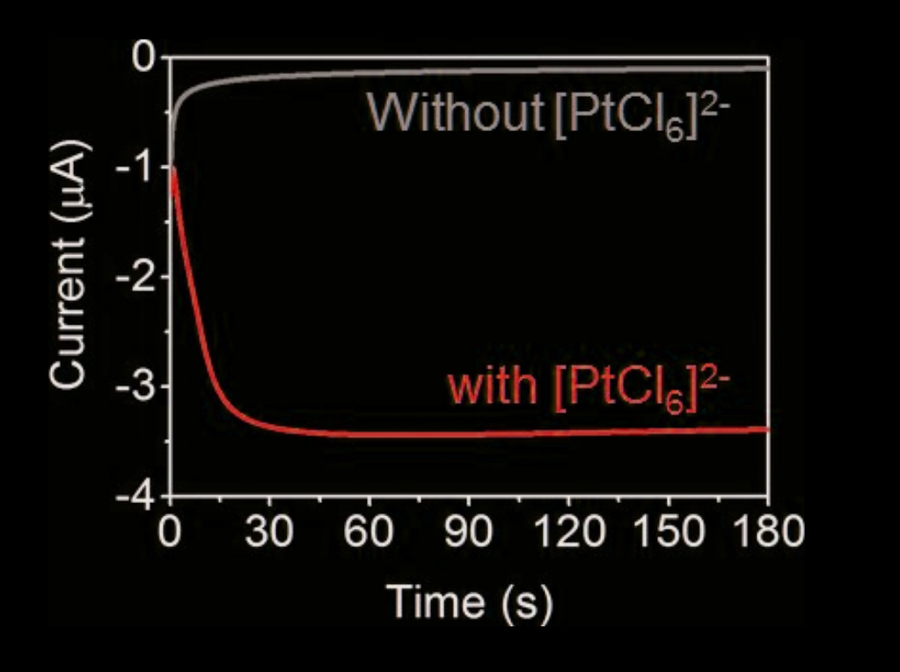
No platinum plating with no aqueous platinum ?!?
Pt⁴⁺ + 4e⁻ → Pt⁰

Slide 6
Ni-Mo!

Slide 7
No Dory tho ☹

Slide 8
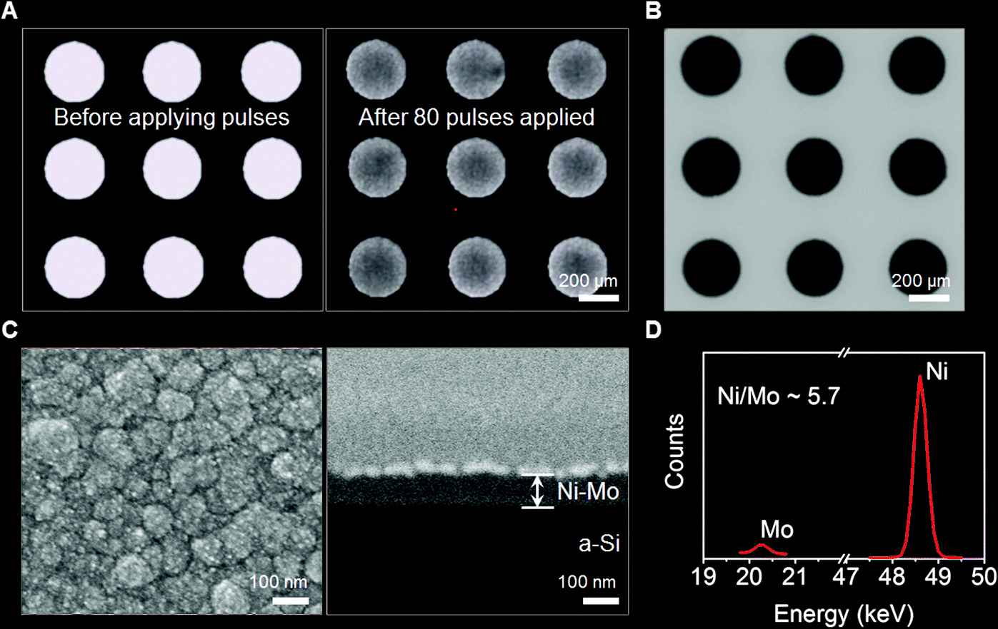
Ni-Mo deposition by pulsing reveals roughened conformal layer with 5.7 Ni:Mo ratio

Slide 9
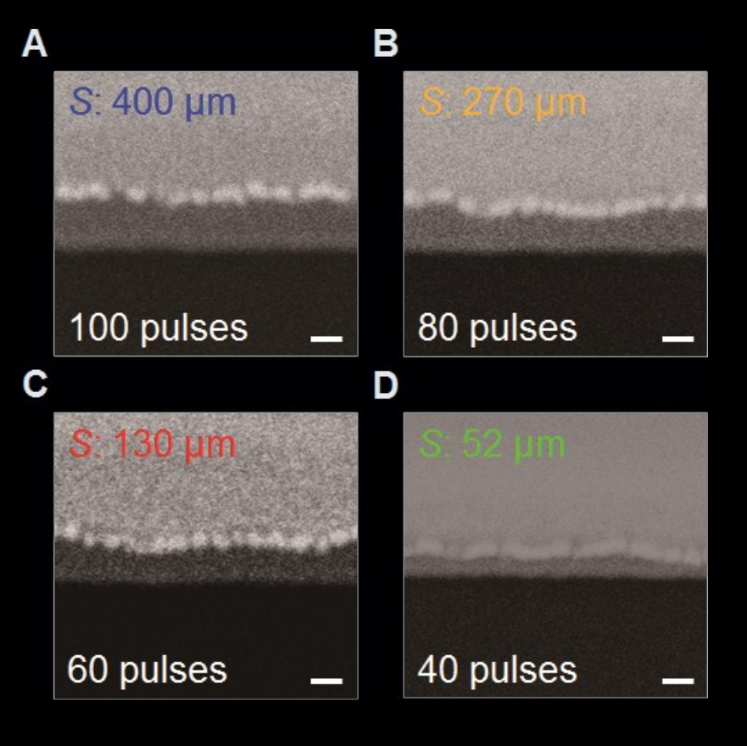
More reduction potential pulses at -0.9 V (vs. Ag/AgCl) applies for 10s creates thicker Ni-Mo layer
100 nm
Ni²⁺ + Mo⁷⁺ + 9e⁻ → Ni-Mo

Slide 10
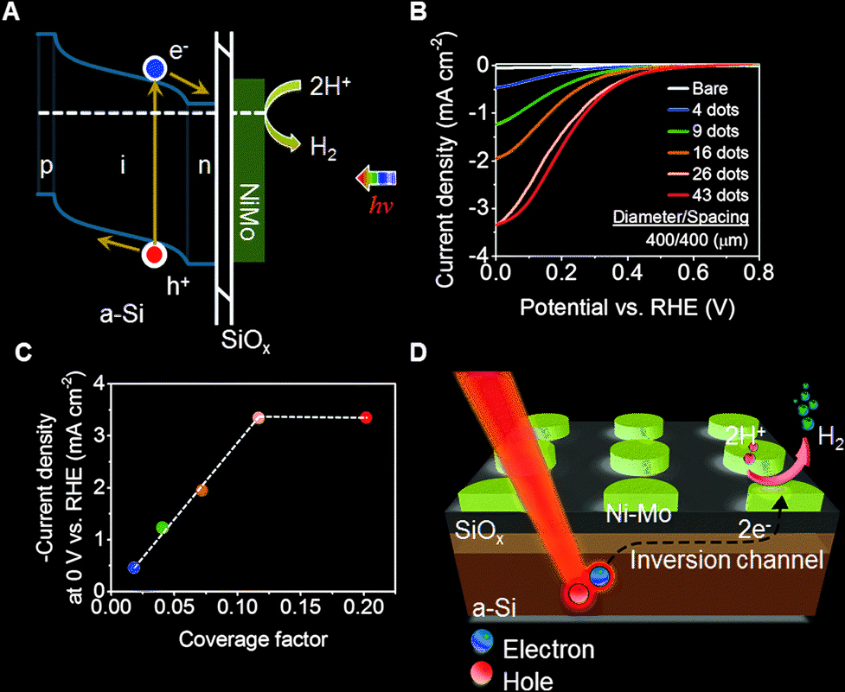
In spotted Ni-Mo systems, the number of dots on the surface increases current density to a point
2H⁺ + 2e⁻ → H₂

Slide 11
In spotted Ni-Mo systems, the number of dots on the surface increases current density to a point
2H⁺ + 2e⁻ → H₂

Slide 12
In spotted Ni-Mo systems, the number of dots on the surface increases current density to a point
2H⁺ + 2e⁻ → H₂

Slide 13
In spotted Ni-Mo systems, the number of dots on the surface increases current density to a point
X
2H⁺ + 2e⁻ → H₂

Slide 14
In spotted Ni-Mo systems, the number of dots on the surface increases current density to a point
X
X
2H⁺ + 2e⁻ → H₂

Slide 15
In spotted Ni-Mo systems, the number of dots on the surface increases current density to a point
X
X
2H⁺ + 2e⁻ → H₂
X

Slide 16
Electrons collected at metal
A
Au³⁺ + 3e⁻ → Au

Slide 17
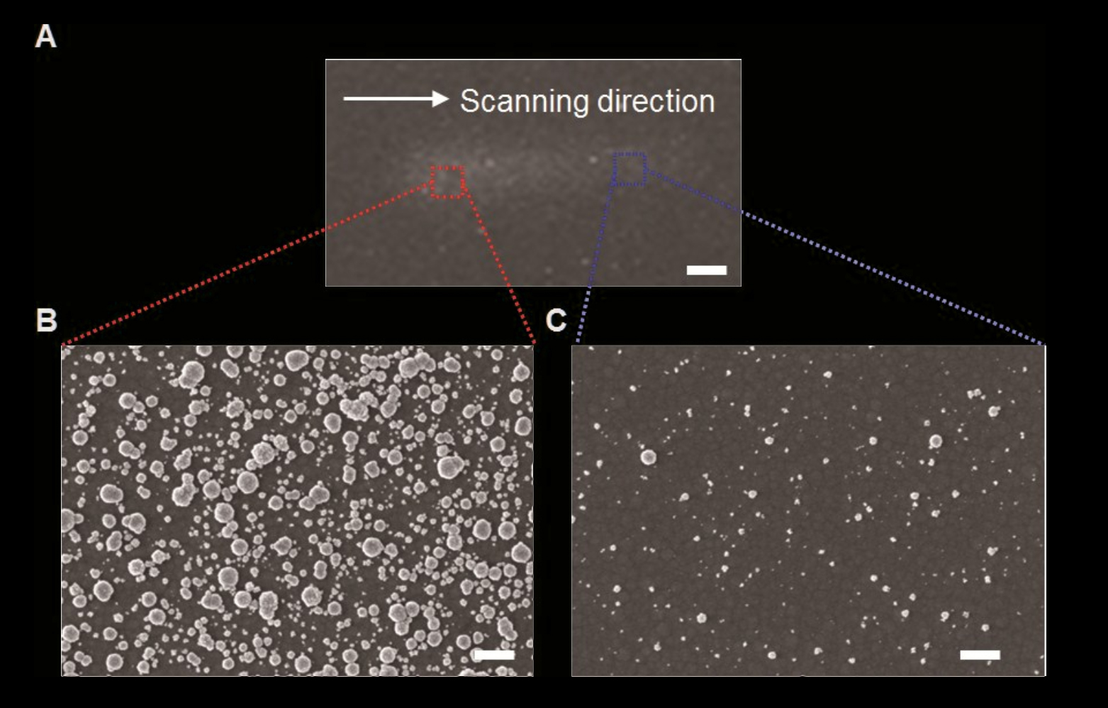
Movement of substrate during deposition creates smearing effect

Slide 18
Spacing and diameter of Ni-Mo spots plateau with added area
2H⁺ + 2e⁻ → H₂

Slide 19
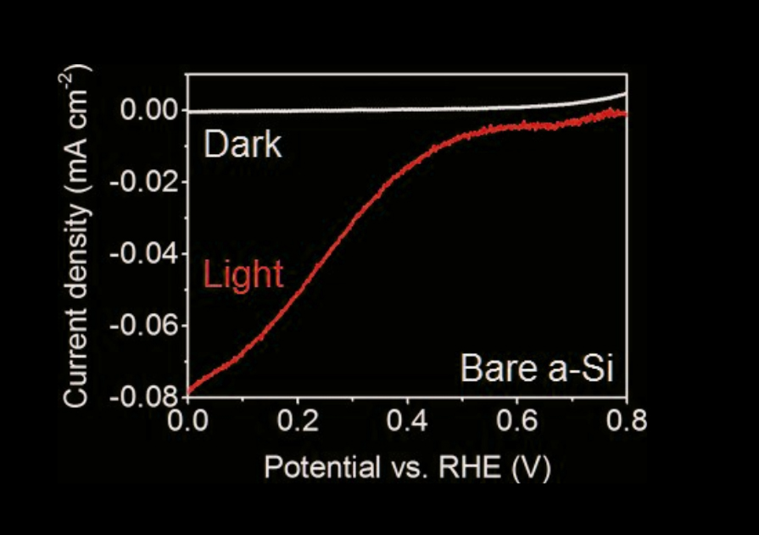
Virtually no hydrogen evolution occurs with bare a-Si
2H⁺ + 2e⁻ → H₂

Slide 20
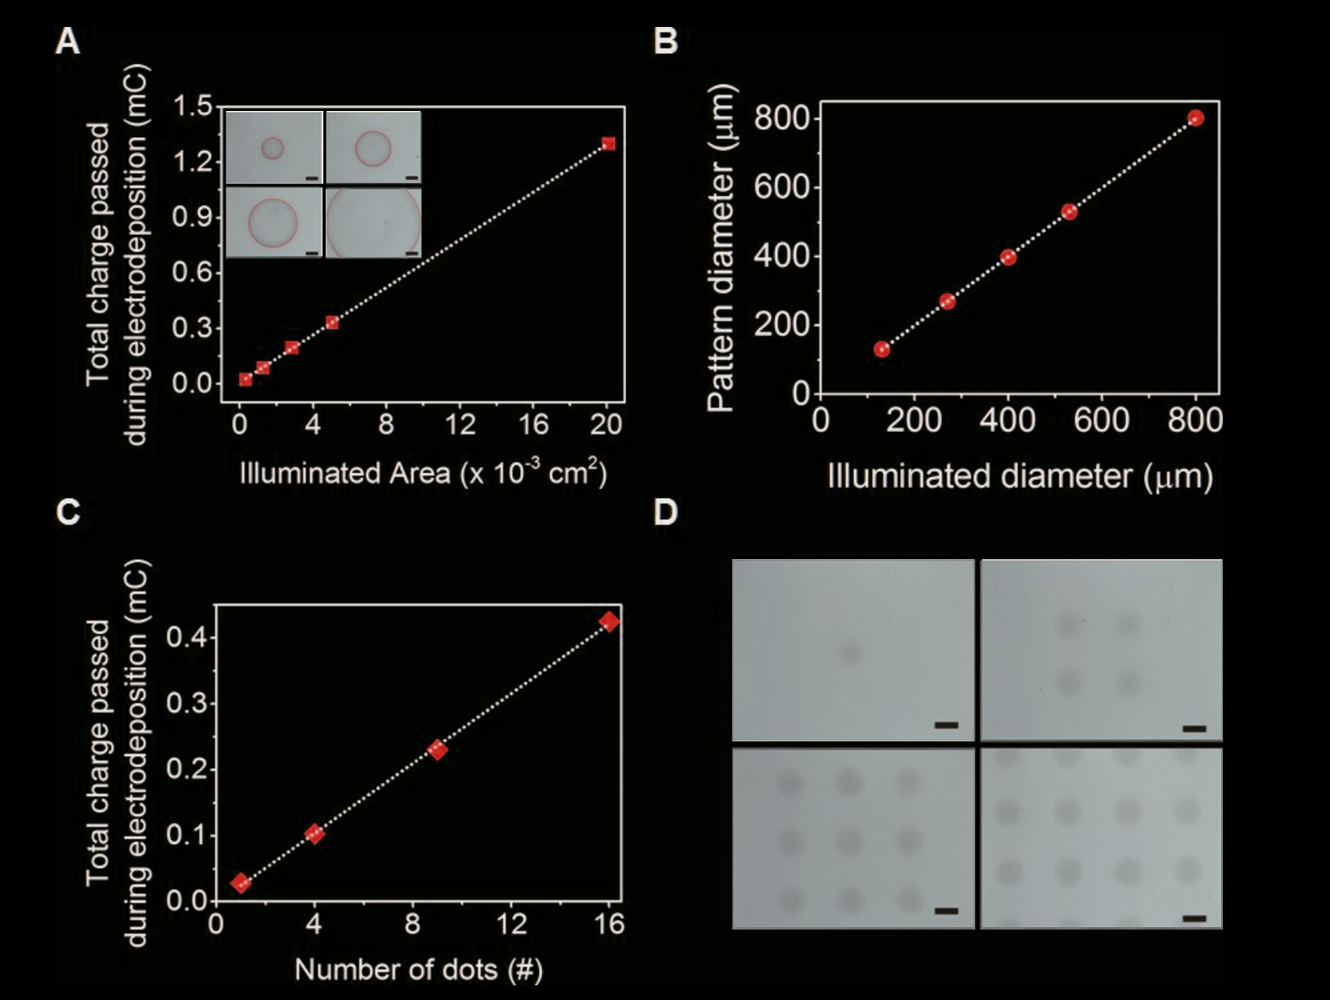
Charge passed linearly proportional with illuminated area, pattern and illumination are 1 to 1

Slide 21
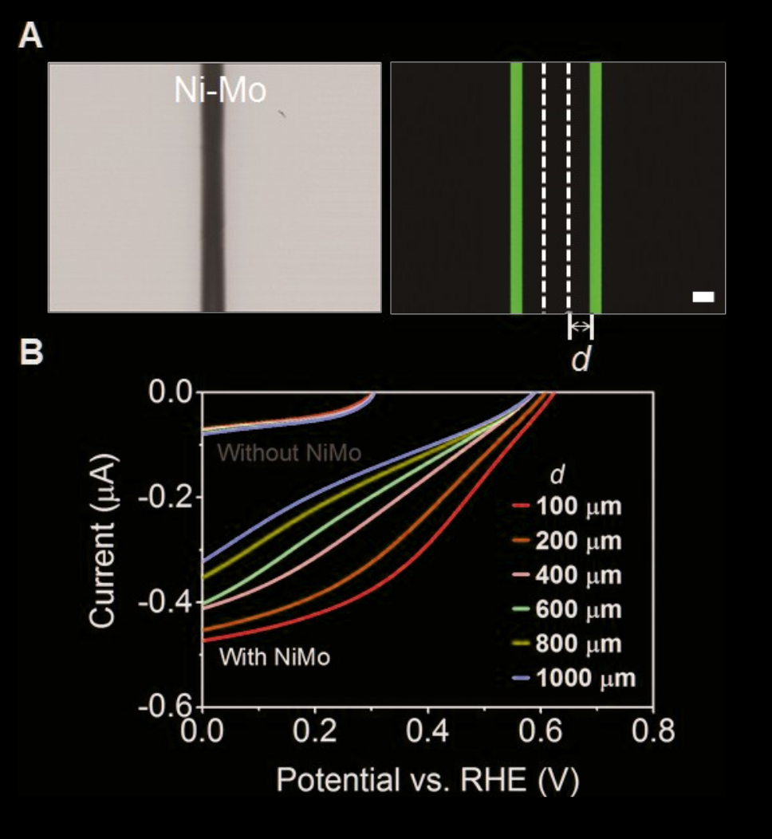
Light absorption closest to initial Ni-Mo deposition causes more hydrogen evolution
2H⁺ + 2e⁻ → H₂

Slide 22
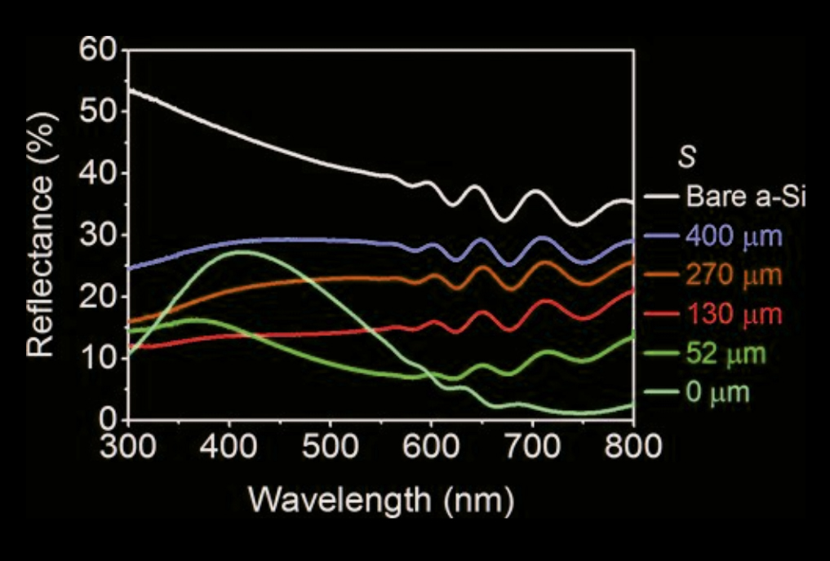
As the pitch of Ni-Mo pattern/SiOx/a-Si changes with a constant Ni-Mo diameter, the total spectral reflectance changes

Slide 23
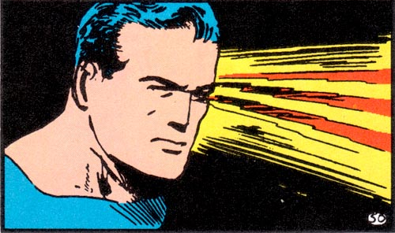
Need to get our X-Ray Vision Ready!

Slide 24
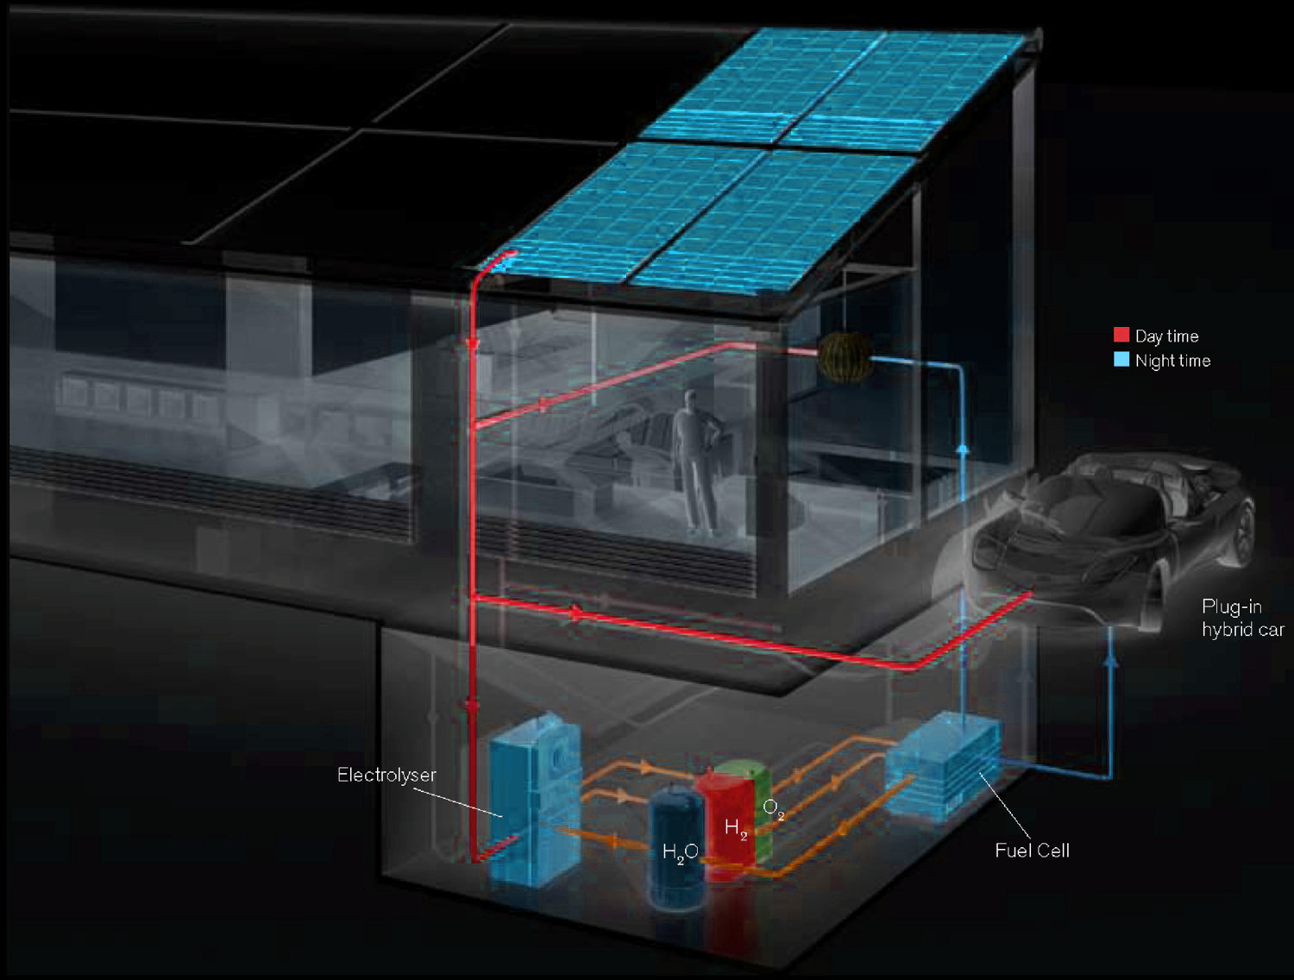
Independent photovoltaic and electrolyzer separates light absorption and chemical catalysis
Nocera, Inorg. Chem. 2009

Slide 25
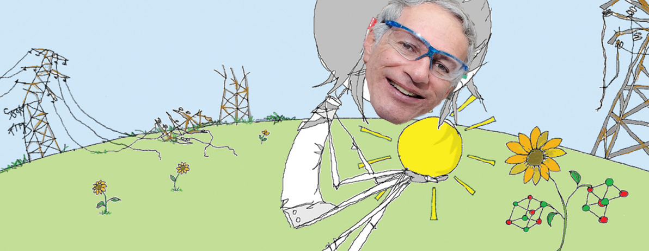
Nocera, Inorg. Chem. 2009

