Slide 1
Growth Algorithm
Absorption
Probability of Addition
Absorbance
Monte Carlo
FDTD
Initial Structure
New Structure
Structure(t+Δt)

Slide 2
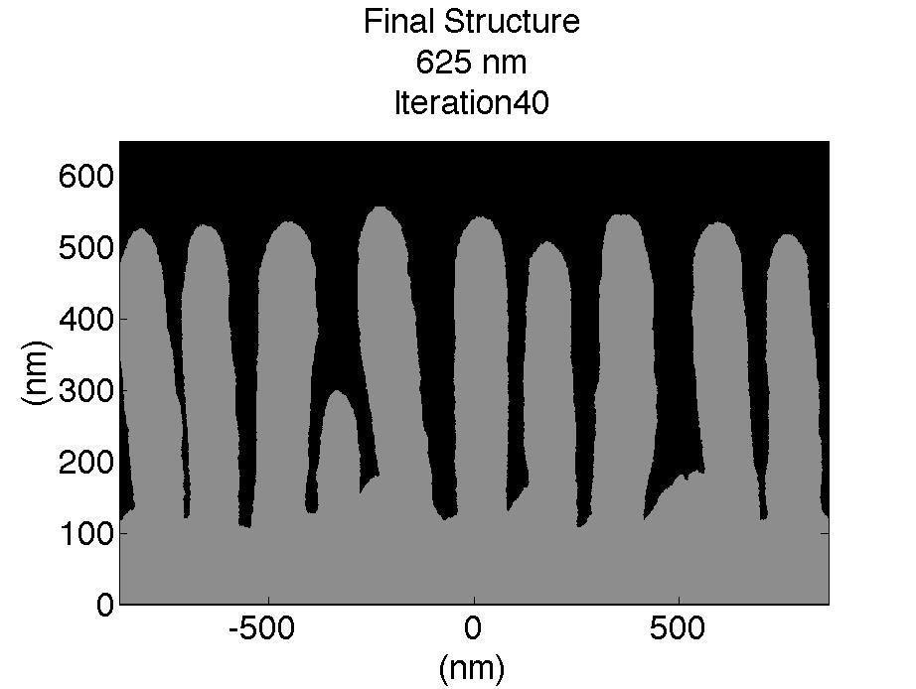
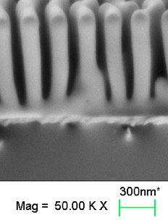
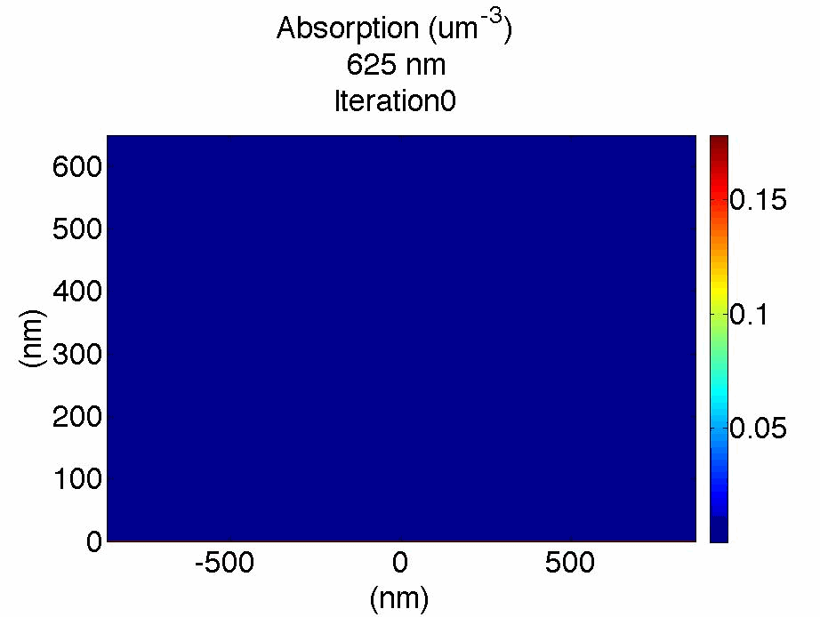
2D Visualization
Simulation
Experiment
625 nm polarized light
Notes:
As you can see, there’s a striking resemblance between the simulations and experimental structures.
Simulation was calculated using
-periodic boundary conditions
-1 nmx1 nm mesh
-experimentally determined nk data.
-surface was initially a bare Si substrate

Slide 3
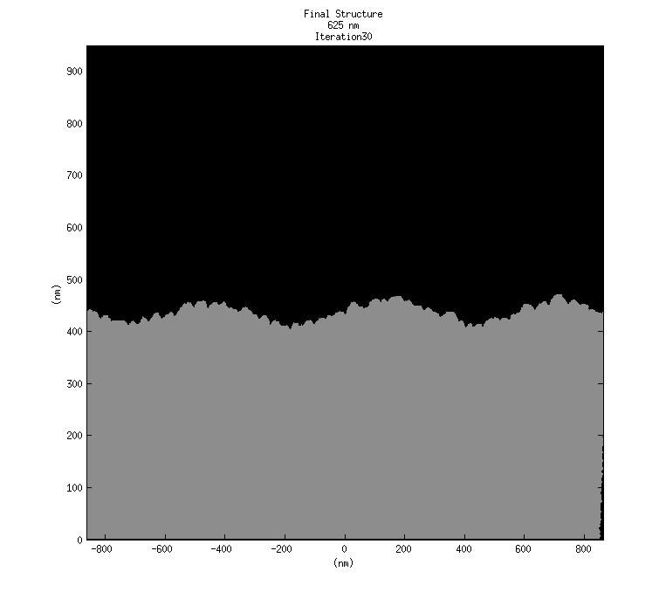
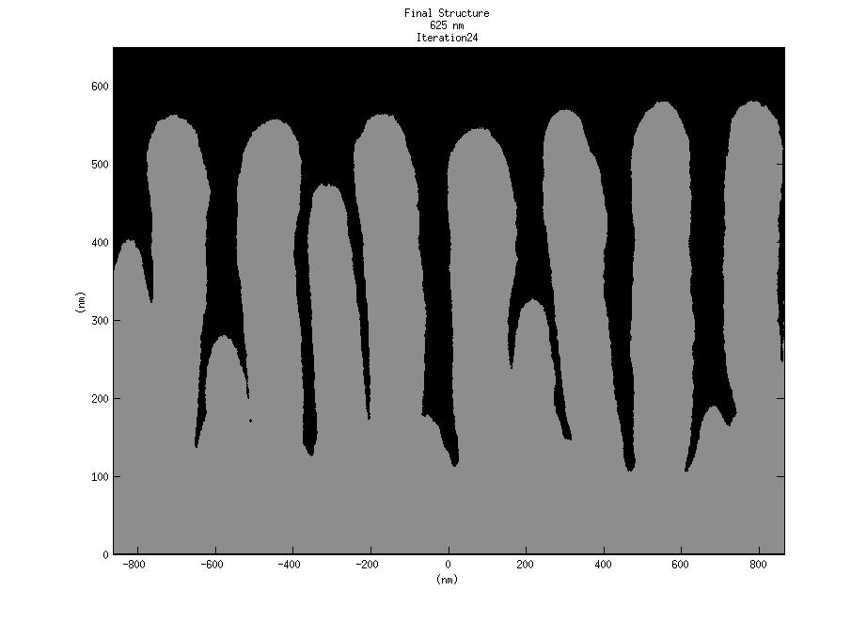
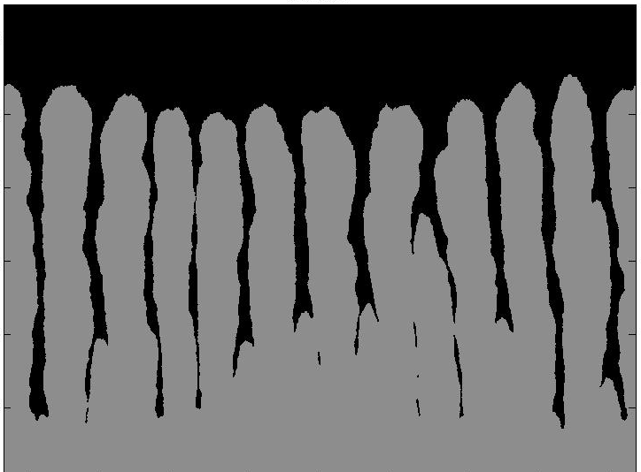
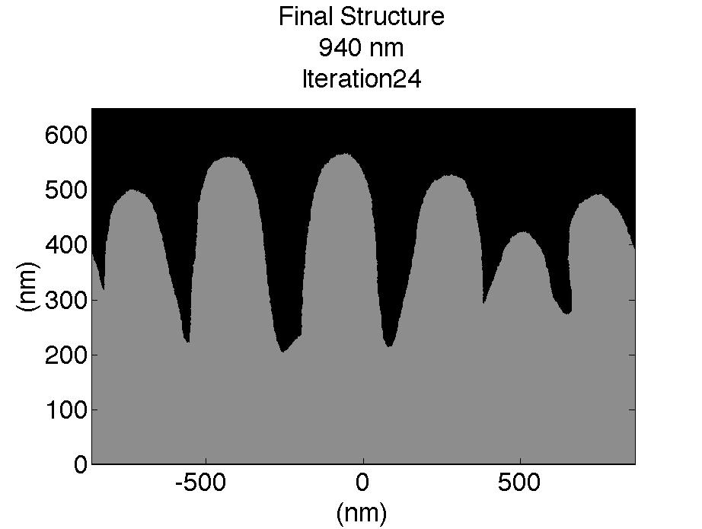
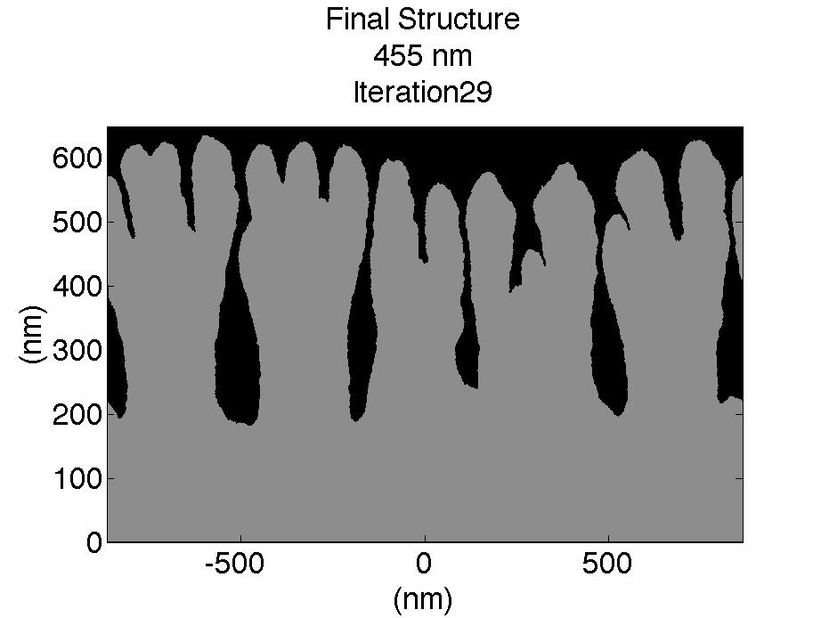
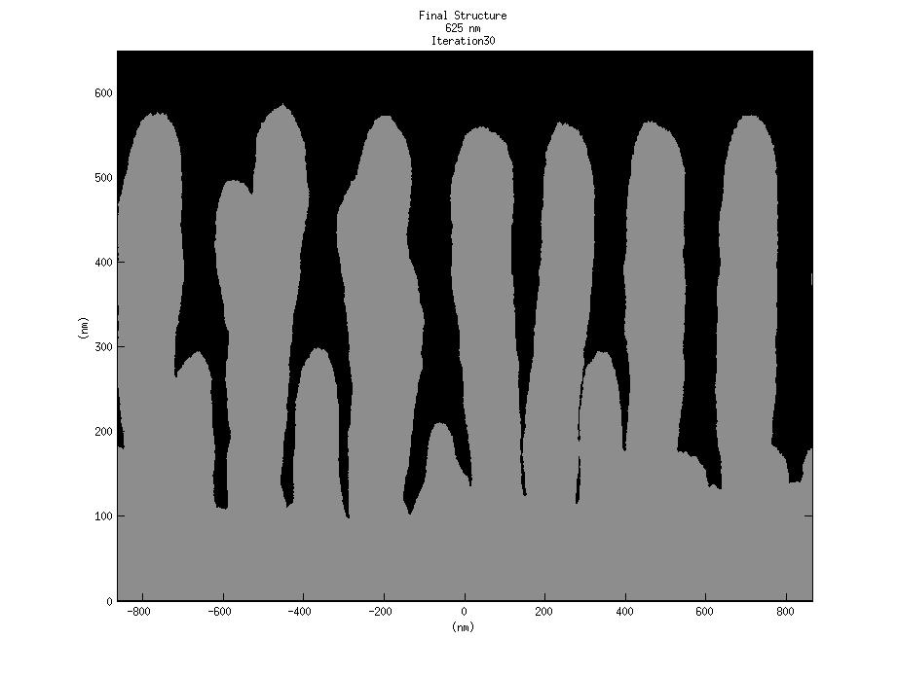
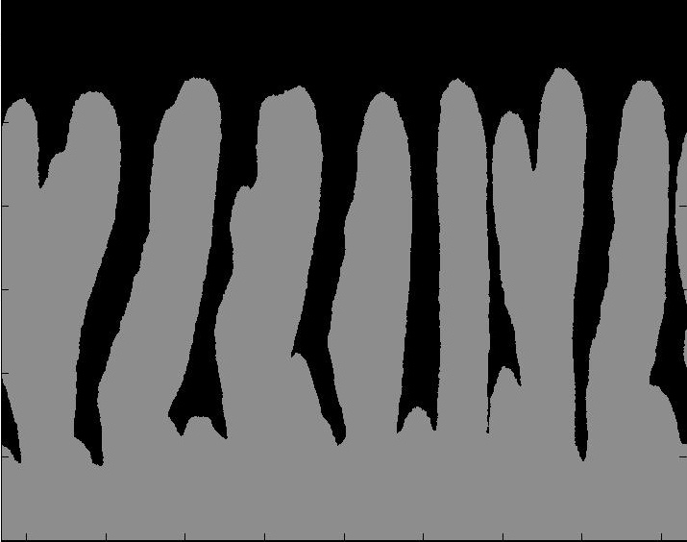
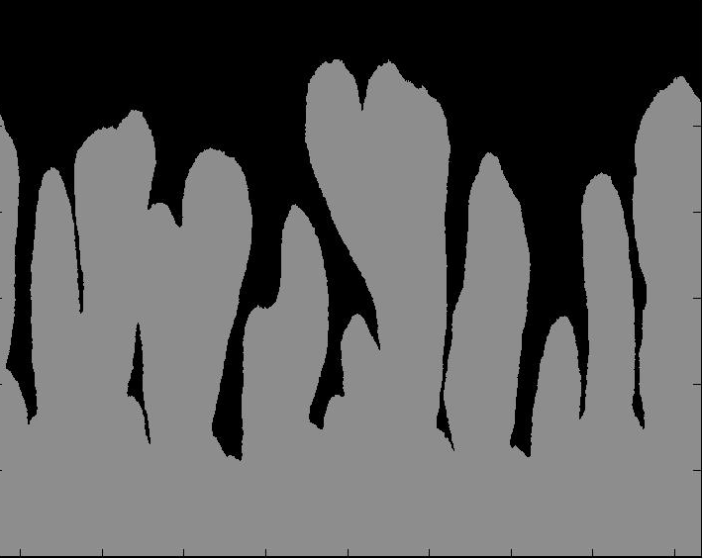
Simulated Morphology Control
Polarization
Left-Right
In-Out
Wavelength
405 nm
625 nm
940 nm
940 -> 455 nm
Angle
15˚
30˚
45˚
1 µm

Slide 4
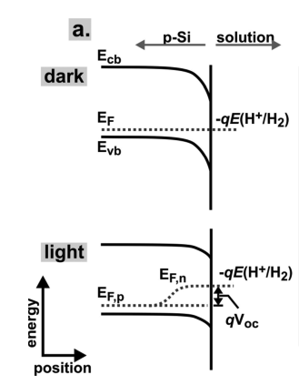
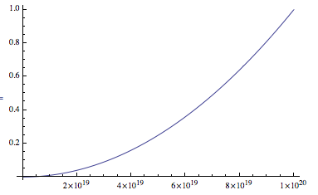
Monte Carlo Model
Normalized Rate
(Probability of Adding Mass)
Boettcher, JACS 133, 1216-1219, (2011)
Power Absorbed
Notes:
The model is very straightforward. I’m assuming an Arrhenius rate constant governs the deposition of material. The driving force is the local difference in the quasi fermi levels or Voc. Plugging in non degenerate expressions for the quasi fermi levels yields a rate equation which is quadratic. Here G is the generation rate and tao is the carrier lifetime. I’ll show you what the simulations looked like in a moment.
When I came up with this, I was picturing our system to look something like the diagram on the left. I think this is a reasonable assumption for our system too.

Slide 5
Uniqueness?
E
E
Fermi Level Splitting Model

Slide 6
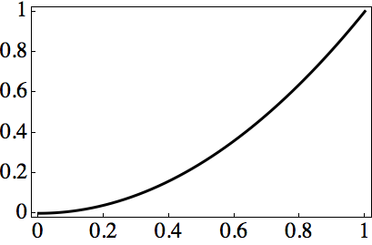
Growth Model
Local light absorption leads to an increase in the local growth rate.
semiconductor
liquid
hν > E_{g}
e⁻
Approximate Growth Rate (nm/s)
Energy (eV)
E_{F,n}
-qE(A⁺/A)
E_{F,p}
h⁺
X10²⁰
Generation Rate (cm⁻³)
Notes:
In more detail, we assumed that the rate of deposition could be approximated by an Arrhenius form. Here, the driving force is the local difference in the quasi fermi levels. Plugging in non degenerate expressions for the quasi fermi levels yields a rate equation which is a quadratic function of the local power absorption.
When I came up with this, I was picturing our system to look something like the diagram on the left. I think this is a reasonable assumption for our system too.
----- Meeting Notes (4/14/14 16:28) -----
bounding box on plot,
try to calculate rate in physical units
in order to calculate the rate in physical units, I would have to know
----- Meeting Notes (4/23/14 17:32) -----
adjust redox potential level

Slide 7
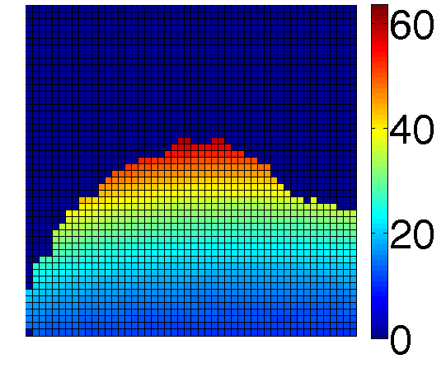
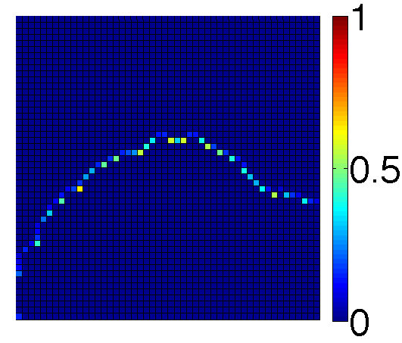
Computational Growth Algorithm
Absorption (t)
mw/cm²
Probability of Addition (t)
Monte Carlo
FDTD
Structure (t)
Structure (t + ∆t)
Notes:
We came up with a computational algorithm to test if our models were adequate to mimic the growth process. In this algorithm, we first calculate the local absorption in the film and then use our model for the photoenhancement rate to calculate a probability of adding mass at each point on the growing interface. We then add mass probabilistically to evolve the structure. We can iterate this process to build up structures
----- Meeting Notes (4/14/14 16:28) -----
use experimental data instead of cartoon.

Slide 8
Batch Simulations
Crude Front End For Batch Simulations
Computer Science Tip:
“If you find yourself doing a repetitive task on a computer, there’s probably a better way”
->Batch Simulations
Inputs:
-Mesh Size
-Simulation Geometry
-1-2 Sources:
Optical Intensity
Wavelength
Polarization
-Etching (more discussion later)

Slide 9
Batch Simulation Workflow
Input
File Type Legend
.m = Matlab Script
.mat = Matlab Data
.lsf = FDTD Script
.fsp = FDTD Simulation
Parameters
From User
Setup.m
Batch Directory
setupParameters.mat
run.m
analysis.m
Sim 1
Sim 2
Sim n
………
output.mat
Output
To User
For Analysis
Figures
Images
results.mat

Slide 10
Growth Mechanism
Local light absorption leads to an increase in the local growth rate.
Light Absorption in Single Lamellae
semiconductor
liquid
hν > E_{g}
e⁻
Energy (eV)
E_{F,n}
-qE(A⁺/A)
E_{F,p}
h⁺
Notes:
In more detail, we assumed that the rate of deposition could be approximated by an Arrhenius form. Here, the driving force is the local difference in the quasi fermi levels. Plugging in non degenerate expressions for the quasi fermi levels yields a rate equation which is a quadratic function of the local power absorption.
When I came up with this, I was picturing our system to look something like the diagram on the left. I think this is a reasonable assumption for our system too.
----- Meeting Notes (4/14/14 16:28) -----
bounding box on plot,
try to calculate rate in physical units
in order to calculate the rate in physical units, I would have to know
----- Meeting Notes (4/23/14 17:32) -----
adjust redox potential level

Slide 11
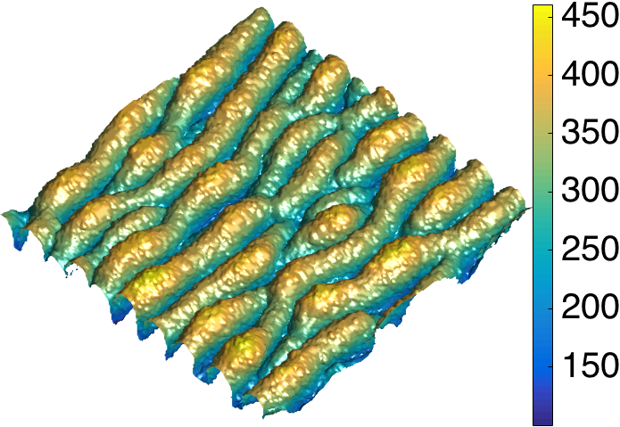
Simple model describes growth: light absorption drives localized deposition
Model Accurately Reproduces Film Morphology
Height (nm)
Simulated Growth
Model Algorithm
1: Surface roughness of deposited material induces variations in absorption profile.
2: Higher absorption regions grow faster and scatter light along interface.
3: Interference from scattering regions create periodic pattern which seeds lamellar growth.
2 µm
Absorption (t)
mw/cm²
Structure (t)
Normalized
Absorption
(Power/Volume)
1
Calculate Absorption
Add Mass
Probability of Addition (t)
Structure (t+ ∆t)
0

Slide 12
Visualization Of Growth
Vertical -> Horizontal Polarization , 780 nm
Notes:
3D Simulations Matrix Operation 12-12-SeTe,780nm, polarization_flip,index_y_10nm_mesh_1_monolayers_short_pulse copy

